Slide 1

Social Media Platform
Adrian Stelter
Jakob Hämmelmann
Laurin Neubert
Tim Knüttel

Slide 2







Use Cases
Users can setup an account
Users can post text posts
Users can reply to posts (comments)
Users can like posts/comments & remove likes after giving them, see like amount
Users can tag posts with topics
Users can edit posts/comments
Users can search for posts by accounts/topics
Notes:
These are the basic functions, we want our Social Media platform to have.

Slide 3
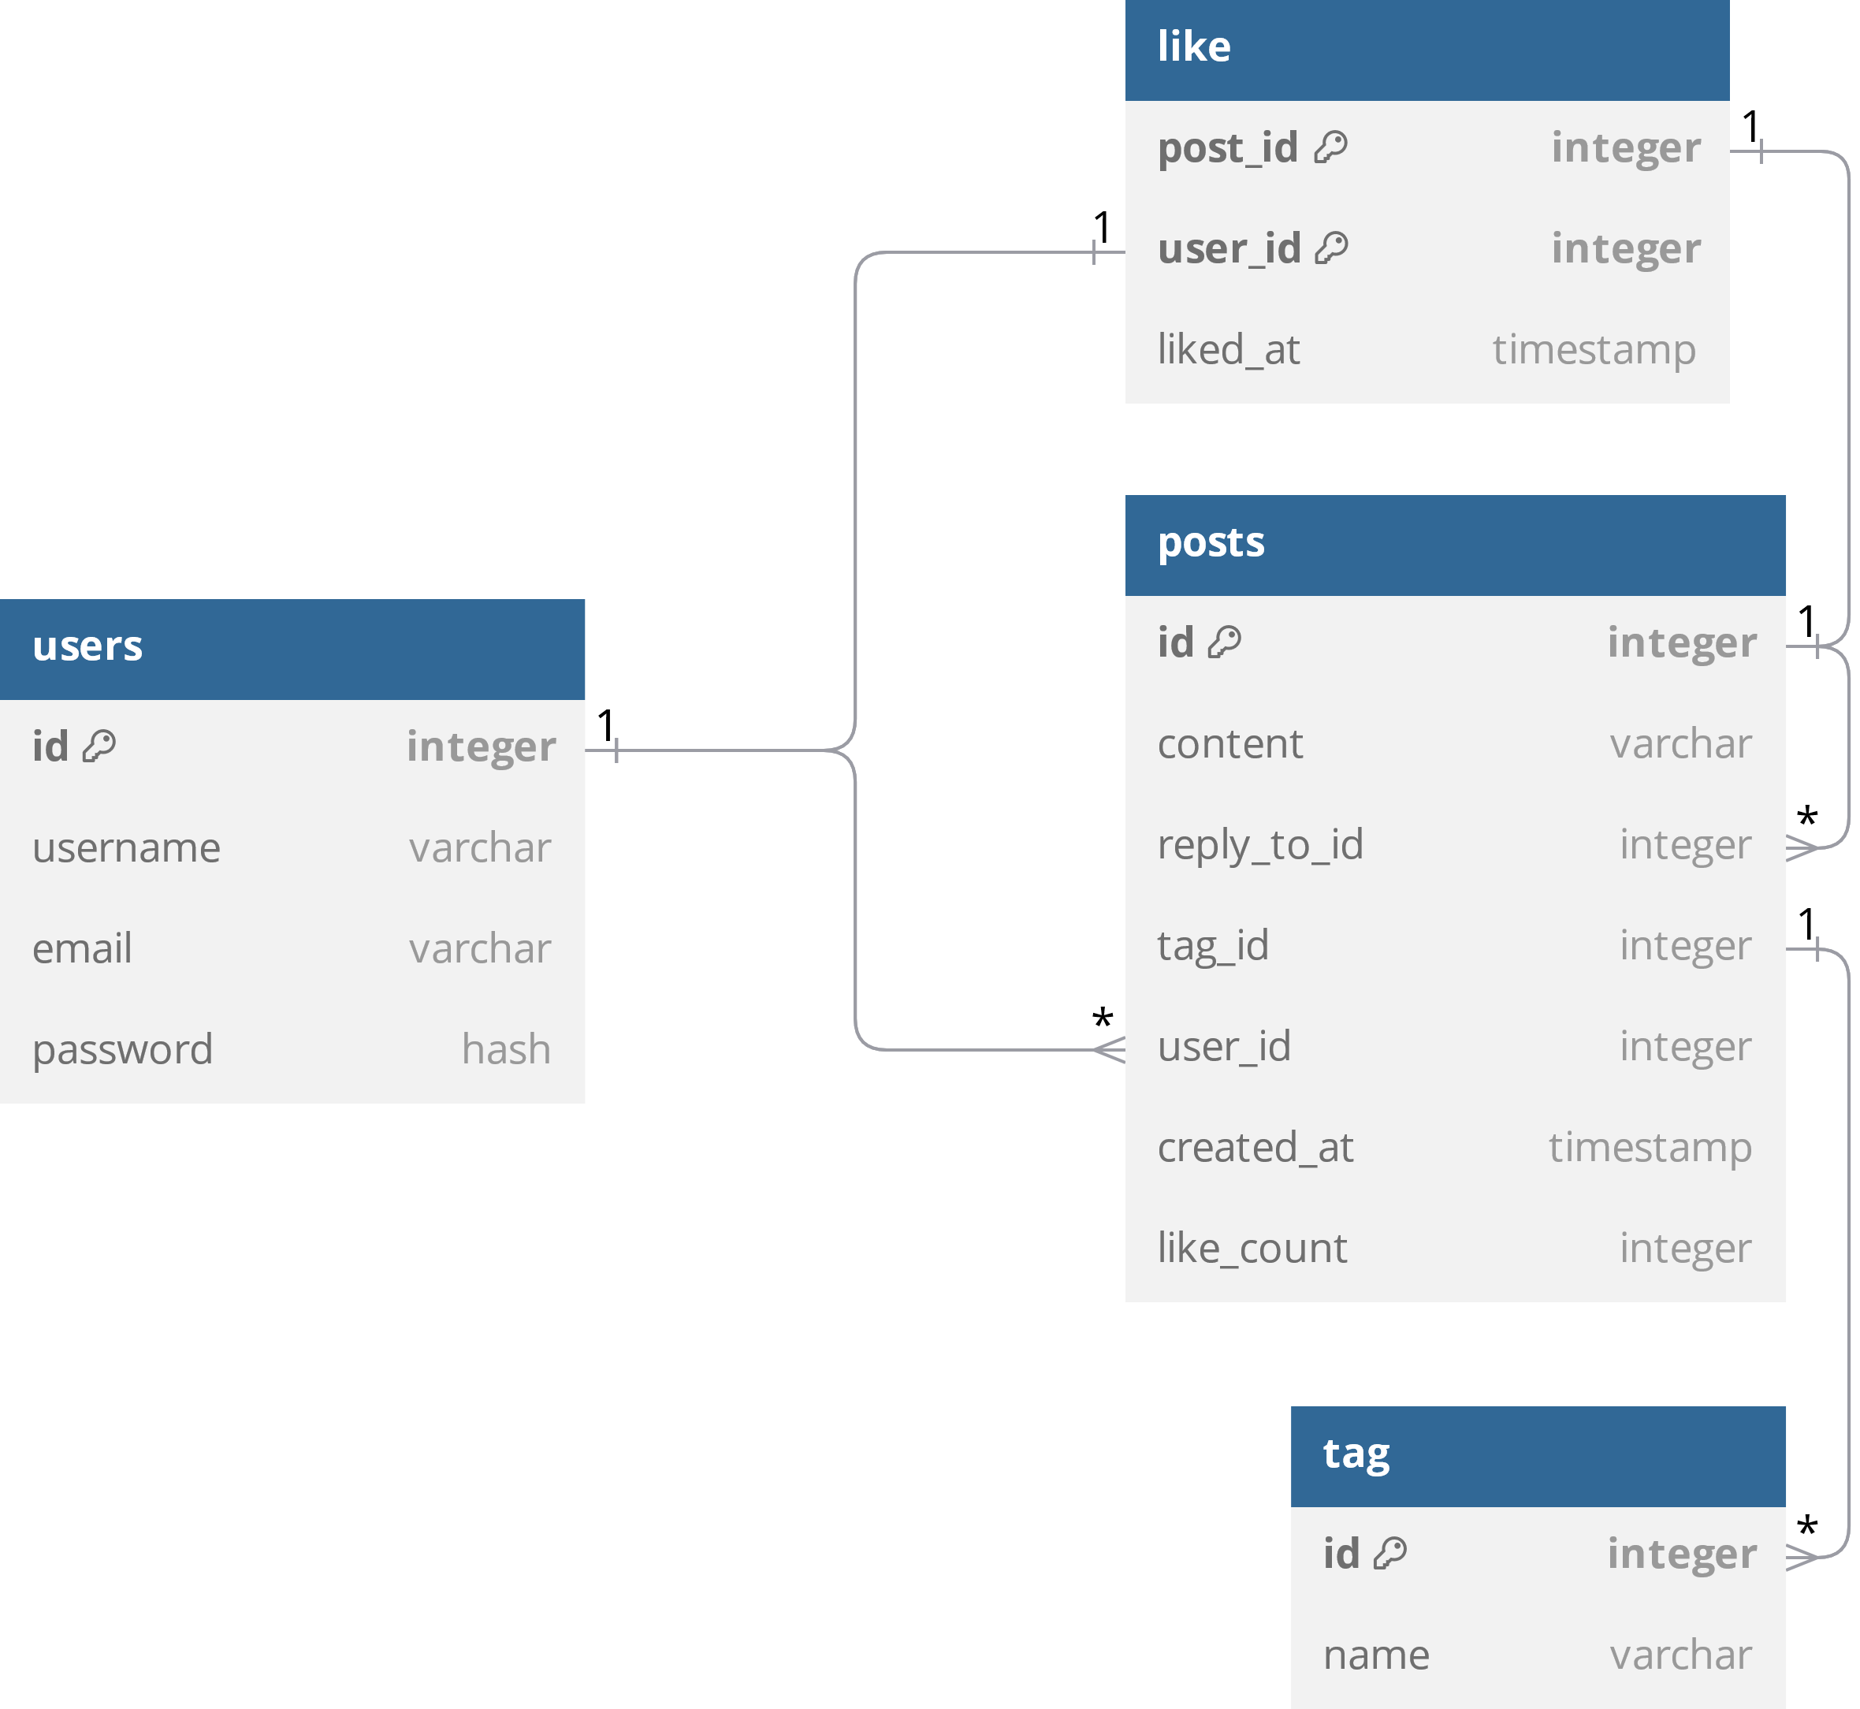
Entities
Notes:
Users: id as primary key, username, E-Mail and password
Posts: id as primary key, content (text), reply_to_id (nullable) if post is a comment, tag_id (nullable) if tagged, user_id for author, created_at, like_count (cached value) refreshing regularly
Like: post_id and user_id as composite key, liked_at timestamp
Tag: id as primary key, name

